Slide 1

Few-Shot Learning Techniques
Under Supervision
Asst. Prof. Rami Zewail
Presented By
Mahmoud Mohammed Taha
Assistant Lecturer, Shoubra faculty of Engineering, Benha University, MOHE PhD student at E-JUST University, Egypt. mahmoud.aboayaad@ejust.edu.eg

Slide 2
Outline
Significance
Objective
Current Status and Trends
Types
Prototypical Network
Matching Network
Relation Network
Implementation, Dataset and result
Conclusion

Slide 3
Introduction to Few-Shot Learning
Few-shot learning is a technique in machine learning where a model is trained to perform tasks with only a few labeled examples per class.
It is particularly useful in scenarios where labeled data is scarce.

Slide 4
Terminology: Meta-learning
Recently, The Scientific community started to use Meta-Learning as term to indicate the "learning-to-learn" paradigm.
First Papers in the 80s, e.g. see Schimidhuber (1987).
Most methods aimed learning meta-parameters via evolutionary algorithms and recurrent networks.
some methods aimed at learning a learning rule (see Bengio, 1990).
₁ Schmidhuber, J., & Blog, A. I. (2020). Metalearning Machines Learn to Learn (1987). URL https://people. idsia. ch/juergen/metalearning. html. https://people. idsia. ch/juergen/metalearning. html.

Slide 5
Terminology: Meta-learning
In this approach, the model is trained on a variety of tasks so that it can learn how to learn quickly when given a few examples of a new task.
The goal is for the model to generalize across tasks and adapt quickly to new, unseen tasks with limited data.

Slide 6
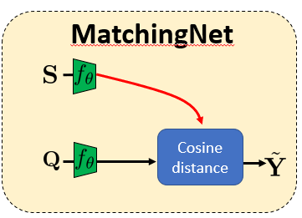
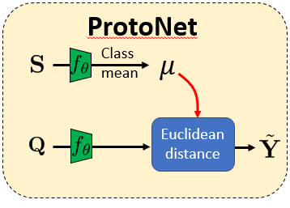
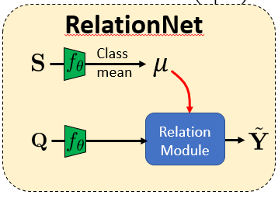
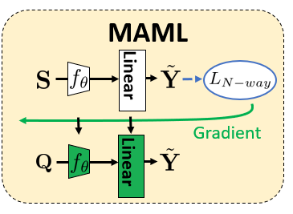
Different Meta-Learning Types

Slide 7
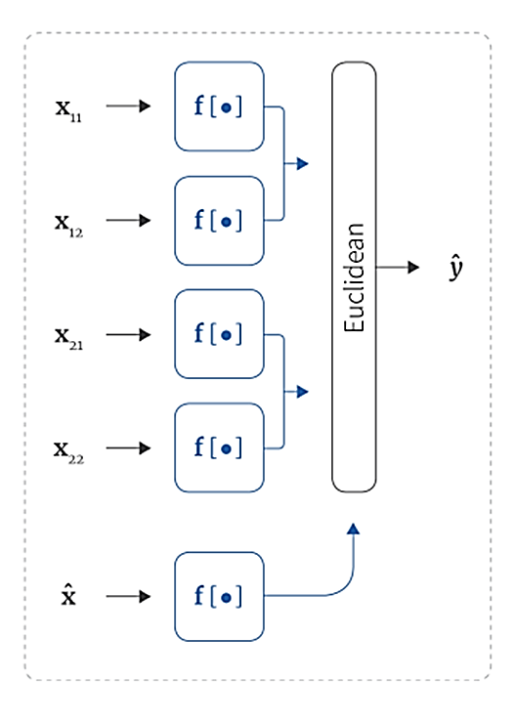
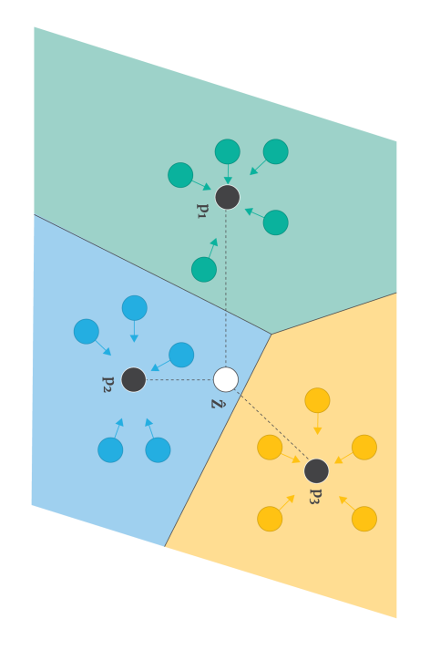
Prototypical Network
Computes distances from the query example to each prototype.

Slide 8
Prototypical Networks
Prototypical Networks classify new samples by comparing them to class prototypes in a learned embedding space.
- Compute class prototypes as the mean of support images.
- Classify using Euclidean distance.
- Results: Achieved accuracy of 70.3% on the dataset.

Slide 9
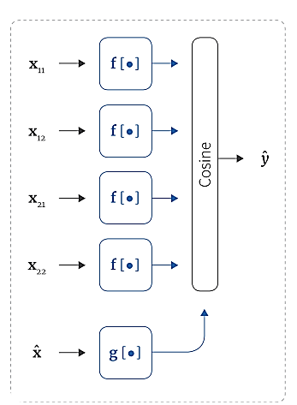
Matching Network
Computes a similarity score between the query and all support examples using a learned attention mechanism.

Slide 10
Matching Networks
Matching Networks map both support and query samples to the same embedding space and use an attention mechanism for classification.
- Components: Embedding extractor, attention model, distance network.
- Results: Achieved accuracy of 67.7%.

Slide 11
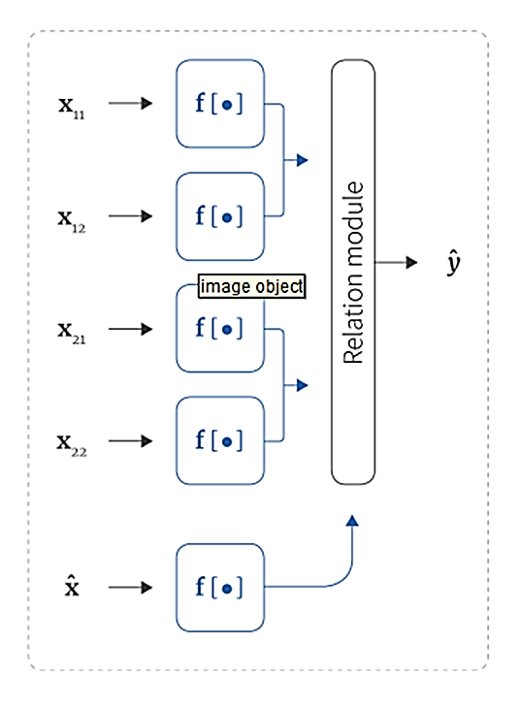

Relation Network
Uses a relation module to compute how similar the query is to each support example.

Slide 12
Relation Networks
Relation Networks learn relationships between query and support examples dynamically.
- Use a neural network to model similarity explicitly.
- Results: Achieved accuracy of 68.1%.

Slide 13
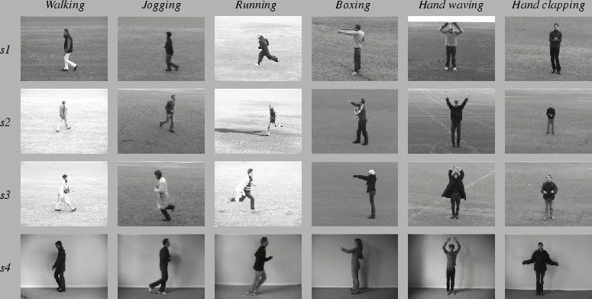
Dataset: Recognition of human actions¹
¹ https://www.csc.kth.se/cvap/actions/

Slide 14
Dataset: Recognition of human actions
The database contains 2391 video sequences featuring six actions (walking, jogging, running, boxing, hand waving, hand clapping) performed by 25 subjects across four scenarios (outdoors, scale variation, clothing variation, indoors). 0

Slide 15
Dataset: Recognition of human actions
Each sequence is 4 seconds on average, recorded at 25fps with a resolution of 160x120 pixels.
The dataset is divided into training (8 subjects), validation (8 subjects), and test (9 subjects) sets.

Slide 16
GEI (Gait Energy Image)
is a widely used representation in action and gait recognition tasks.
It is a 2D image that encodes the motion and posture of a subject during walking or performing an action.

Slide 17
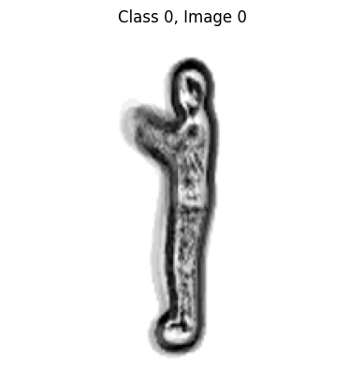
Example: GEI Image of Boxing

Slide 18
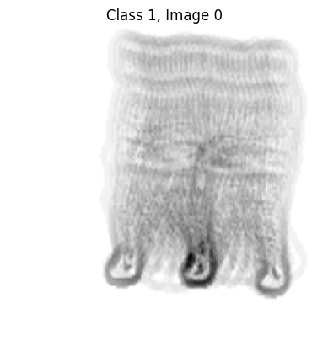
Example: GEI Image of Running

Slide 19
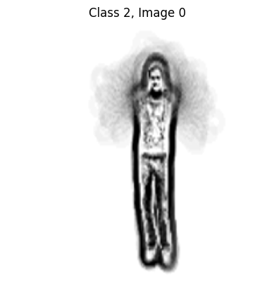
Example: GEI Image of Hand Waving

Slide 20
GEI Classification, Implementation
The implementation in the Few Shot Learning lab involves several key with python such as (preprocessing dataset to generate GEI and training each few-shot type.
Necessary libraries such as matplotlib, numpy, torch, and torchvision are loaded.

Slide 21
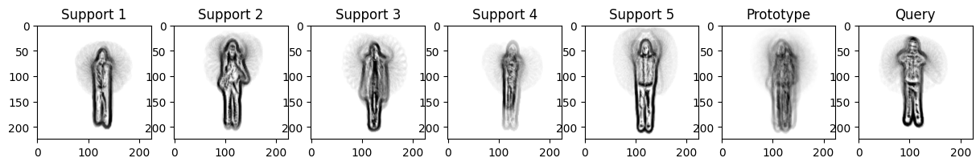
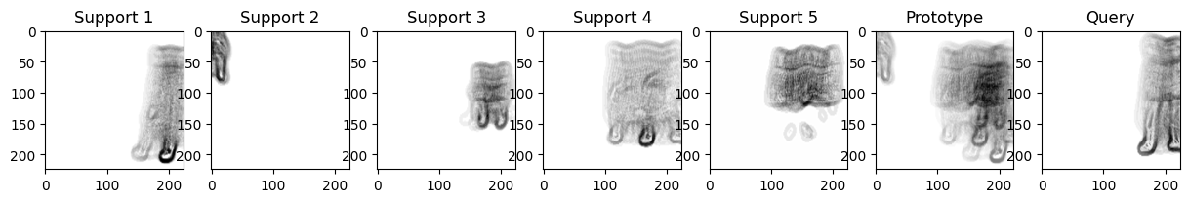
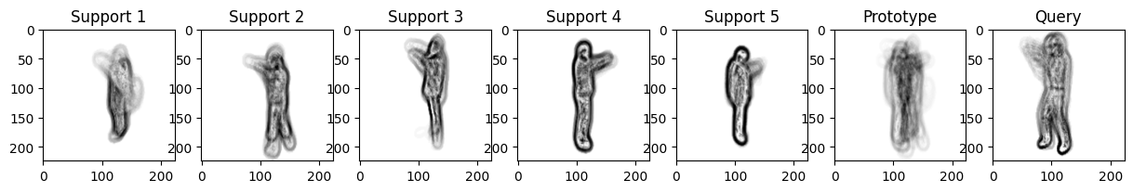
Few-shot Training Example (Prototypical)

Slide 22
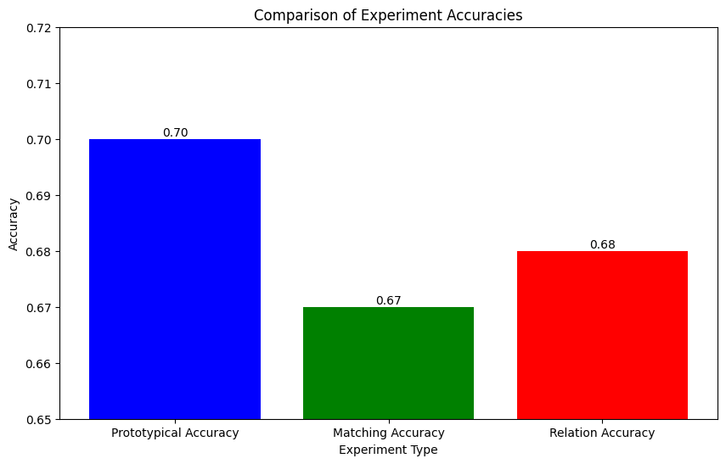
Final results and Comparison
- Prototypical Networks: 70.3%
- Matching Networks: 67.7%
- Relation Networks: 68.1%

Slide 23
Final results and Comparison
Aspect | Prototypical Networks | Matching Networks | Relation Networks
Accuracy | 70.3% | 67.7% | 68.1%
Time to Train | Fast (simple averaging operation) | Moderate (uses attention) | Slow (relation module adds complexity)
Key Components | Embedding extractor, class prototypes | Embedding extractor, attention mechanism | Embedding extractor, relation module
Classification Method | Euclidean distance to prototypes | Attention-based similarity | Neural network for similarity
Strengths | Easy to implement, quick adaptation to new tasks | Effective for small datasets | Dynamic relationship learning

Slide 24
Conclusion
Few-shot learning demonstrates the potential to classify new categories with minimal labeled data, addressing real-world problems where large datasets are unavailable.
The quality of feature embeddings significantly impacts the model's performance.

Slide 25
References
Vinyal et al., Matching networks for oneshot learning, NeurIPS 2016
Snell et al., Prototypical networks for few-shot learning, NeurIPS 2017
Finn et al., Model-agnostic meta-learning for fast adaptation of deep network, ICML 2017
Sung et al., Learning to compare: Relation network for few-shot learning, CVPR 2018

Slide 26
Thank you
Mahmoud Mohammed Taha
Assistant Lecturer, Shoubra faculty of Engineering, Benha University, Scholarship student at E-JUST University, Egypt. mahmoud.aboayaad@ejust.edu.eg

